Slide 1
EE313: Wireless Communications
Professor WANG Rui
Department of Electronic & Electrical Engineering (EEE)
Southern University of Science & Technology (SUSTech)
Fall 2022

Slide 2
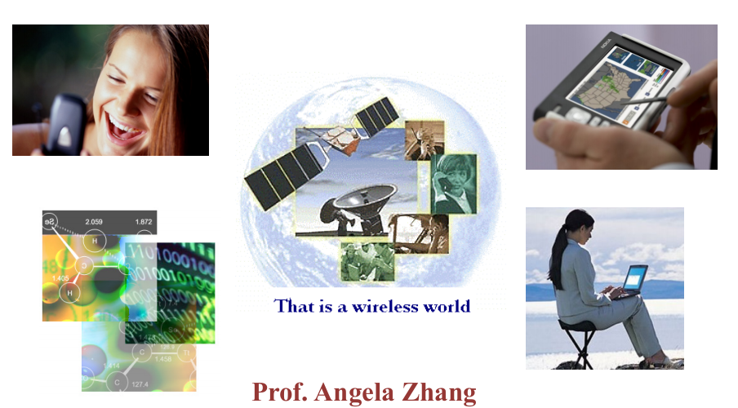
This is a wireless world!

Slide 3
Course Information
Course Materials:
Blackboard System
Lectures:
Tuesday 10:20-12:10 (3rd Teaching Building, Rm 206)
Instructor:
Prof. WANG Rui (wangr@sustech.edu.cn)
TA:
李乾任(12232135@mail.sustech.edu.cn)
任振裕(renzy2022@mail.sustech.edu.cn)
林铖(linc2022@mail.sustech.edu.cn)

Slide 4
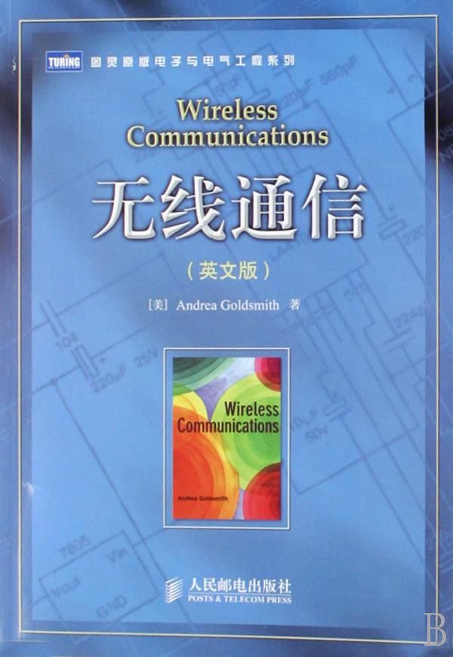
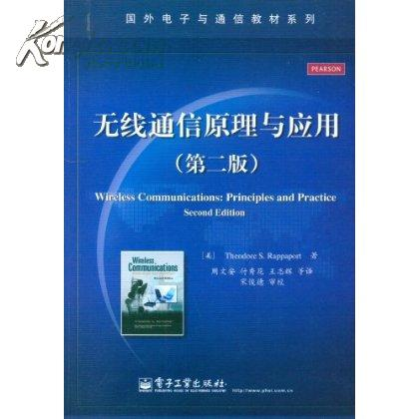
Course Information
Textbook:
Andrea Goldsmith, Wireless Communications, Cambridge Press
Reference book:
Theodore S. Rappaport, 无线通信原理与应用（第二版），电子工业出版社
Assessment:
Theoretical part:
Final exam
Midterm exam
Assignments & Quizzes
Lab part:
In-class hand-in
After-class report

Slide 5
Course Information
Goal:
understand the fundamental principles underlying wire-less communications
Contents:
characteristics and performance limits of wireless systems
techniques of wireless communications
mathematical tools to analyze the systems
in-sights and trade-offs associated with system design
the applications of the principles in current and envisioned wireless systems

Slide 6
Course Syllabus
Overview of Wireless Communications
Path Loss, Shadowing, and Fading Models
Capacity of Wireless Channels
Digital Modulation and its Performance
Diversity
Coding
Adaptive Modulation
Equalization
MIMO Systems
Multicarrier Modulation
Spread Spectrum
Typical Wireless Systems

Slide 7
Overview of Wireless Communications
Outline
History of Wireless Communications
Current and Emerging Wireless Systems
Characteristics of Wireless Communications
Technical Challenges

Slide 8
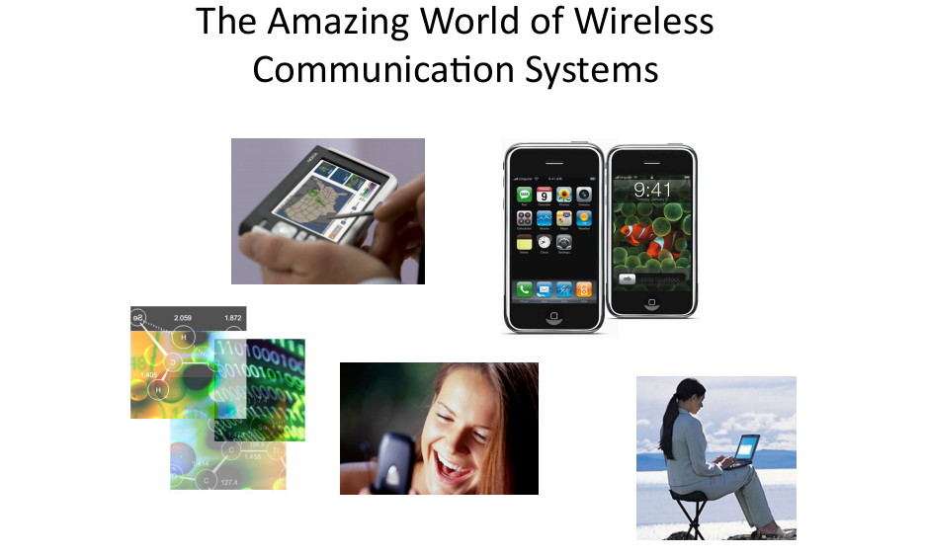
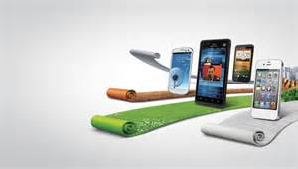
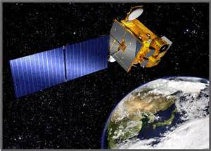
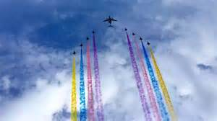
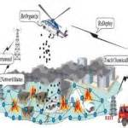
The Amazing World of Wireless Communication Systems

Slide 9


Early History of Wireless Communications
Many people in history used light for communication
Flag signal
Smoke signal (150 BC China, Greece)
Set of signal combination convey messages
Observation stations along the road act as relays
Telegraph and telephone replace the early comm. networks
1838 Morse, 1876 Bell
Electromagnetic waves for modern wireless communications
Faraday, Maxwell, Hertz

Slide 10
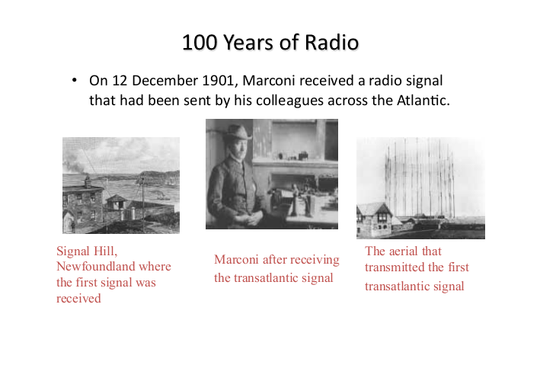
120+ Year of Radio

Slide 11
History of Wireless Communications
Many sophisticated military radio systems were developed during and after WW2
The first packet radio system:
ALOHANET
University of Hawaii 1971
Cellular has enjoyed exponential growth since 1988, with almost 5 billion users worldwide today
Ignited the wireless revolution
Voice, data, and multimedia ubiquitous
Use in third world countries growing rapidly
Wi-Fi is enjoying tremendous success and growth
Wide area networks (e.g. WiMax) and short-range systems other than Bluetooth (e.g. UWB) less successful

Slide 12
Current and Emerging Wireless Systems
Cellular Systems
Wireless LANs
WiGig and mmWave
Satellite Systems
Bluetooth
Zigbee Radios
Sensor Networks
Biomedical Networks
Cognitive Radios

Slide 13
Scarce Wireless Spectrum
$$$
Scarce and Expensive

Slide 14
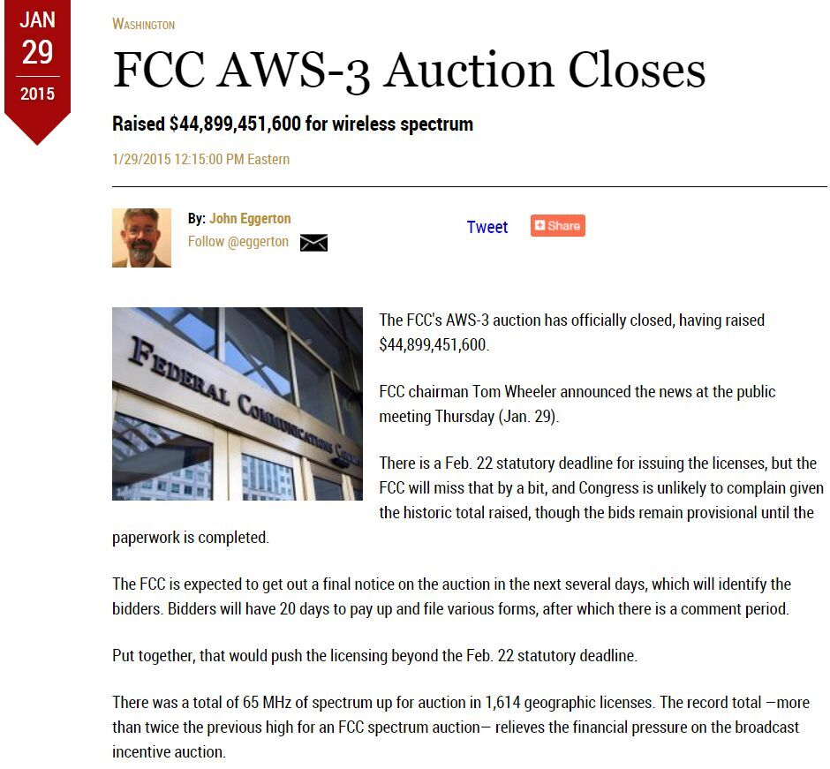
Value of Wireless Spectrum
2015年1月，美国联邦通信委员会（FCC）65MHz无线频谱拍卖获得449亿美元

Slide 15
Spectrum Regulation
Spectrum is a scarce public resource
Spectrum allocation in US is controlled by FCC (commercial) or OSM (defense)
FCC auctions spectral blocks for set applications
Some spectrum set aside for universal use
Worldwide spectrum controlled by ITU-R

Slide 16
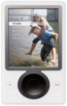
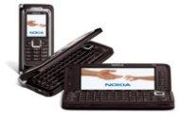
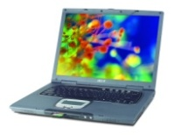
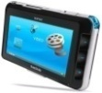
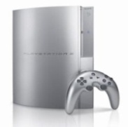
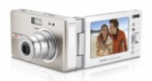
Spectral Reuse
Due to its scarcity, spectrum is reused
In licensed bands
and unlicensed bands
BS
Cellular
WiFi, BT, UWB,…
Reuse introduces interference

Slide 17
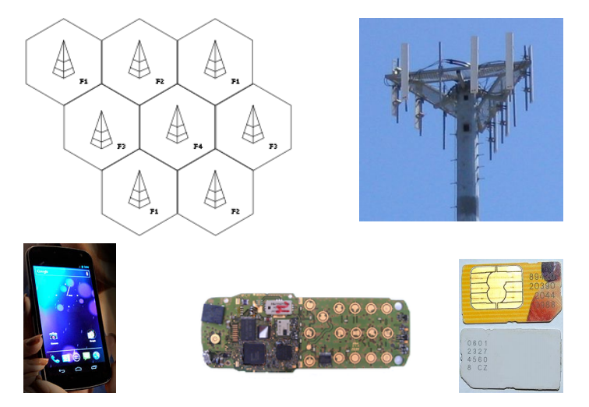
The Most Widely Deployed: Cellular Systems

Slide 18
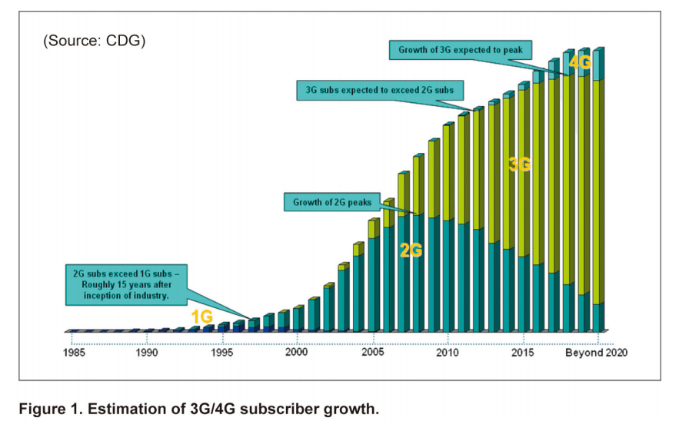
1G, 2G, 3G, 4G

Slide 19
4G/LTE Cellular
Much higher data rates than 3G (50-100 Mbps)
3G systems has 384 Kbps peak rates
Greater spectral efficiency (bits/s/Hz)
Through MIMO, adaptive techniques
Flexible use of up to 100 MHz of spectrum
20 MHz spectrum allocation common
Low packet latency (<5ms)
Reduced cost-per-bit
Support for multimedia
All IP network

Slide 20
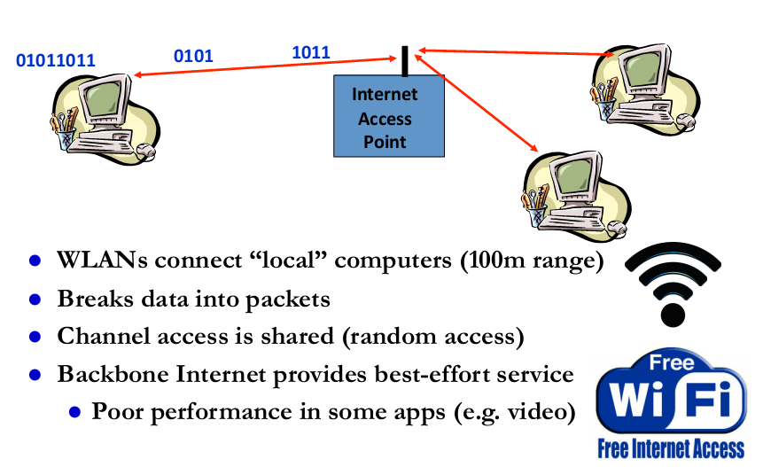
Wireless Local Area Network (WiFi)

Slide 21
Wireless LAN Standards
802.11b (Old – 1990s)
Standard for 2.4GHz ISM band (80 MHz)
Direct sequence spread spectrum (DSSS)
Speeds of 11 Mbps, approx. 500 ft range
802.11a/g (Middle Age– late 1990s-early 2000s)
Standard for 5GHz band (300 MHz)/also 2.4GHz
OFDM in 20 MHz with adaptive rate/codes
Speeds of 54 Mbps, approx. 100-200 ft range
802.11n/802.11ac (around 2010 to now)
Standard in 2.4 GHz and 5 GHz band
Adaptive OFDM /MIMO in 20/40/80/160 MHz
Antennas: 2-4, up to 8
Speeds up to 600Mbps (> 1 Gbps), approx. 200 ft range
Other advances in packetization, antenna use, etc.
Many
WLAN
cards
have
all 3
(a/b/g/n)
The latest:
WiFi 6

Slide 22
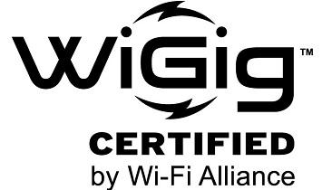
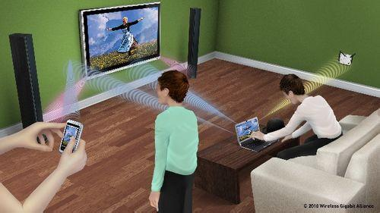
WiGig
New standards operating in 60 GHz band
Data rates of 7-25 Gbps
Bandwidth of around 10 GHz (unregulated)
Range of around 10m (can be extended)
Uses/extends 802.11 MAC Layer
Applications include PC peripherals and displays for HDTVs, monitors & projectors

Slide 23
mmWave
802.11ad & ay
Couples 60GHz with massive MIMO and better MAC
Promises long-range communication with Gbps data rates
Hardware, propagation and system design challenges
Much research on this topic today

Slide 24
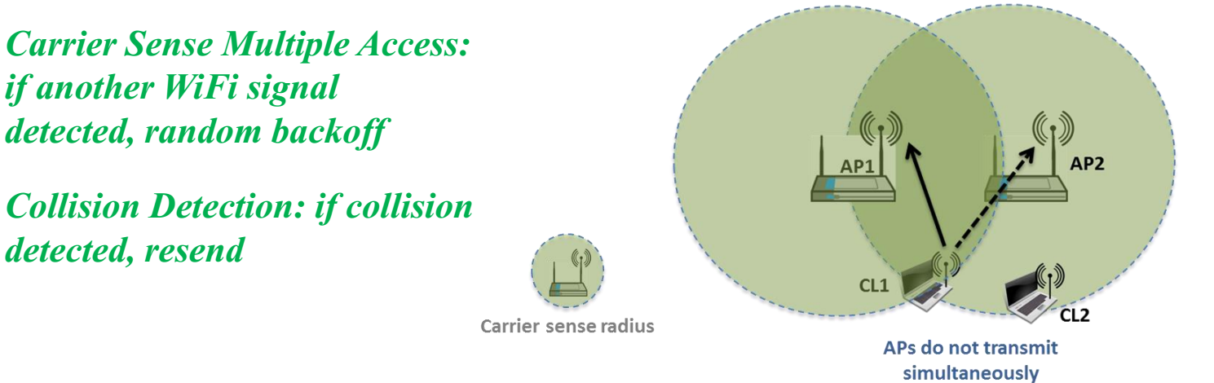
Why does WiFi Performance Sucks?
The WiFi standard lacks good mechanisms to mitigate interference, especially in dense AP deployments
Multiple access protocol (CSMA/CD) from 1970s
Static channel assignment, power levels, and carrier sensing thresholds
In such deployments WiFi systems exhibit poor spectrum reuse and significant contention among APs and clients
Result is low throughput and a poor user experience

Slide 25
Satellite Systems
Cover very large areas
Different orbit heights
GEOs (39000 Km) versus LEOs (2000 Km)
Optimized for one-way transmission
Radio (XM, Sirius) and movie (SatTV, DVB/S) broadcasts
Most two-way systems struggling or bankrupt
Global Positioning System (GPS) use growing
Satellite signals used to pinpoint location
Popular in cell phones, PDAs, and navigation devices

Slide 26
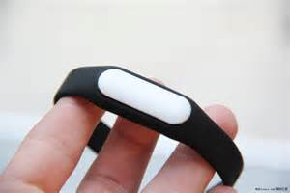
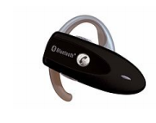
Bluetooth/ Bluetooth Low Energy
Cable replacement RF technology (low cost)
Short range (10m, extendable to 100m)
2.4GHz band (crowded)
1 Data and 3 voice channels, up to 3Mbps
Widely supported by telecommunications, PC and consumer electronics companies
Keyboard, mouse, earphone, wrist strap, blood pressure monitor

Slide 27
ZigBee Radios
Low-Rate WPAN
Data rates of 20, 40, 250 Kbps
Support for large mesh networking or star clusters
Support for low latency devices
CSMA-CA channel access
Very low power consumption
Frequency of operation in ISM bands
Focus is primarily on low power sensor networks

Slide 28
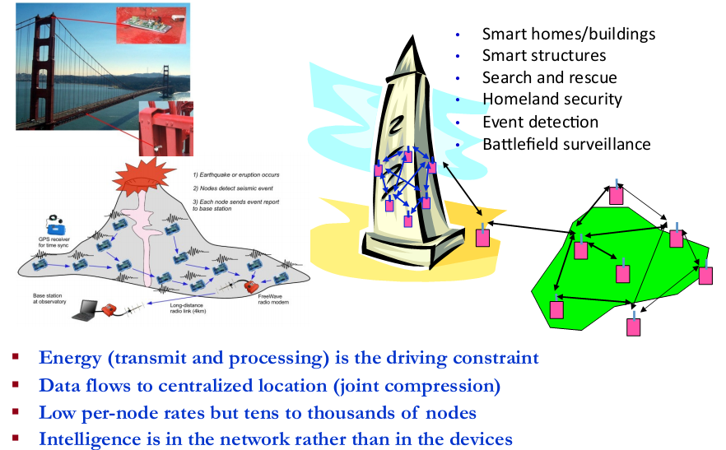
Wireless Sensor Networks

Slide 29
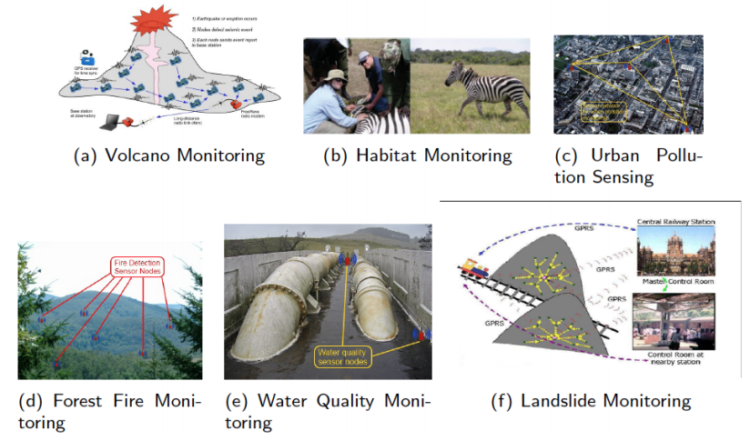
Example WSNs: Environmental Monitoring

Slide 30
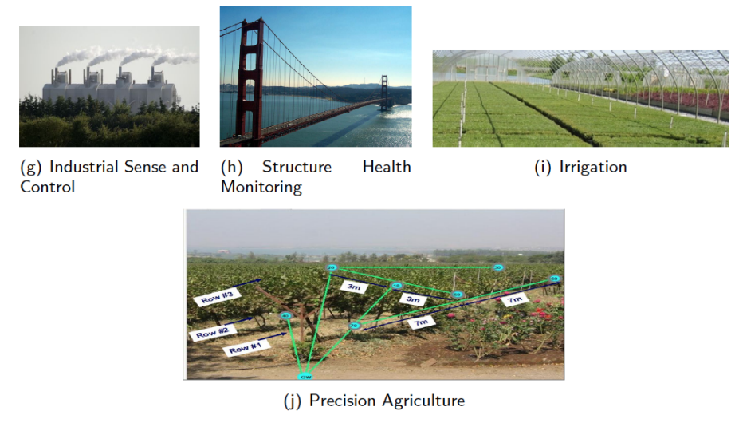
Example WSNs: Industrial and Agricultural Monitoring

Slide 31
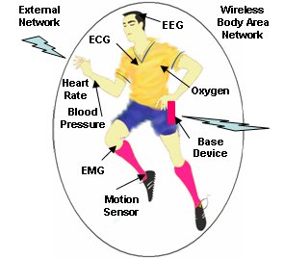

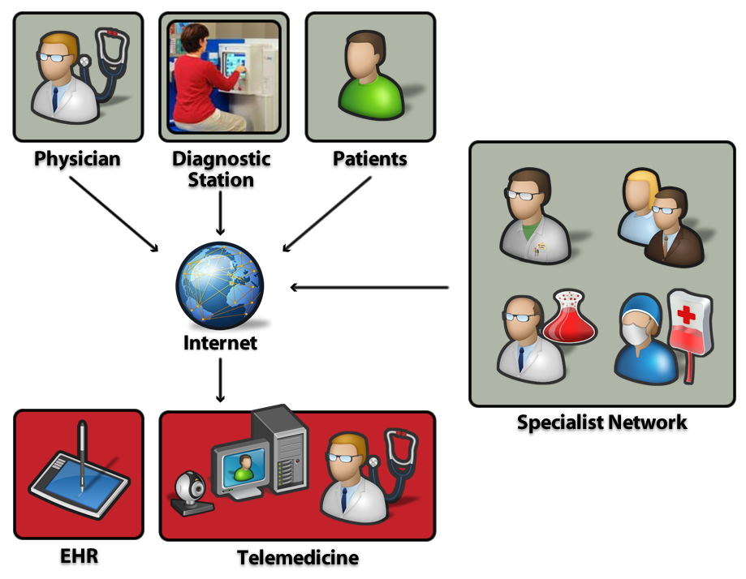
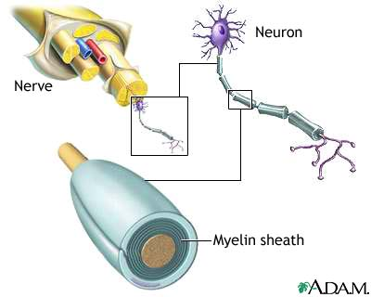
Applications in Health, Biomedicine and Neuroscience
Neuro/Bioscience
EKG signal reception/modeling
Brain information theory
Nerve network (re)configuration
Implants to monitor/generate signals
In-brain sensor networks
Body-Area
Networks
Doctor-on-a-chip
Recovery from
Nerve Damage
Wireless
Network

Slide 32
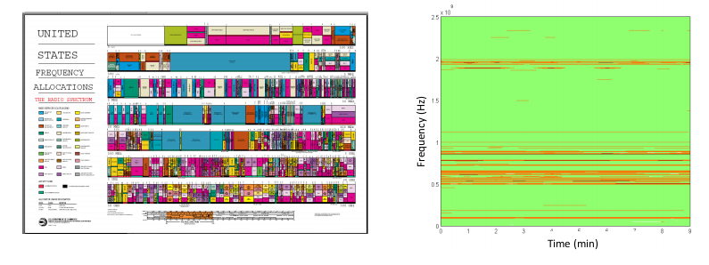
Scarce Radio Spectrum
Spectrums has been sliced and allocated to existing users
Recent measurements show 70% allocated spectrums are not utilized
Unlicensed bands - biggest innovations in spectrum efficiency

Slide 33
Cognitive Radio
Cognitive radio requirements
Co-exists with legacy wireless systems
Use their spectrum resources
Does not interfere with them
Cognitive radio properties
RF technology that “listens to” the usage of the spectrum
Knowledge of primary users’ spectrum usage as a function of time and location
Rules of sharing the available resources (time, freq, space)
Intelligence to determine optimal transmission (bandwidth, time) based on primary user’s behavior

Slide 34
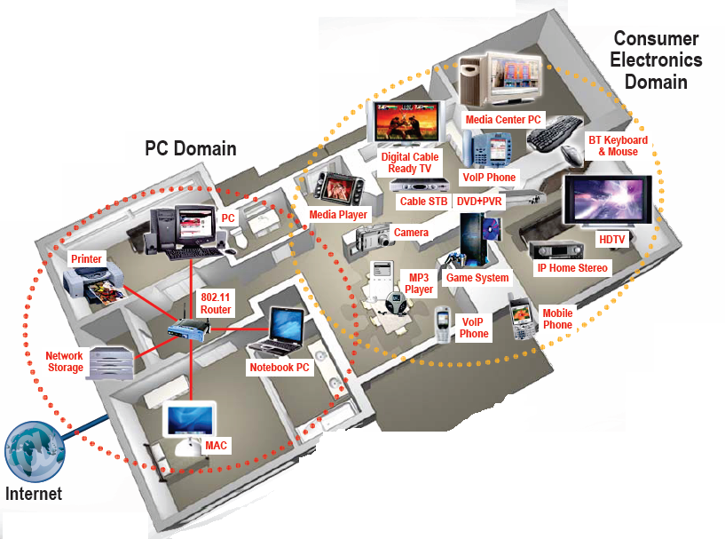

Future Wireless Networks
Ubiquitous Communication Among People and Devices
Next-generation Cellular
Wireless Internet Access
Wireless Multimedia
Sensor Networks
Smart Homes/Spaces
Automated Highways
In-Body Networks
All this and more …

Slide 35
Summary: What is Wireless Communications
Wireless Communication is the transfer of information between two or more points that are not connected by an electrical conductor
Information is transmitted using electromagnetic (EM) waves, also known as radio waves
For wireless services to be meaningful, we need
Systems
Devices
Transmission and reception techniques
Applications

Slide 36
Wireless Systems are Segmented and Diverse
Segmented on applications, systems or coverage regions
Applications: voice, Internet access, web browsing, paging, short messaging, video teleconferencing, sensing, distributed control…
Systems: cellular, WLAN, satellite, ad hoc networks…
Coverage region: personal, home, campus, city, regional, global
Diverse: different wireless applications have different requirements
Wired networks can satisfy diverse requirements using a single protocol
Wireless cannot! Fragmented in the near future!

Slide 37
Difference compared with wired comm.
Channel varying
Movement
Open medium and high interference
Limited bandwidth
High BER
Limited resource and energy
Totally different design for various wireless systems

Slide 38
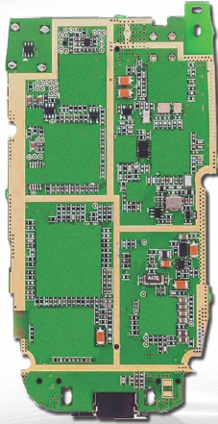
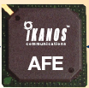
Technical Challenges
Network Challenges
Scarce spectrum
Demanding/diverse applications
Reliability
Ubiquitous coverage
Seamless indoor/outdoor operation
Device Challenges
Size, Power, Cost
Multiple Antennas in Silicon
Multiradio Integration
Coexistance
BT
FM/XM
GPS
Cellular
DVB-H
Apps
Processor
WLAN
Media
Processor
Wimax

